Slide 1
Management of Quality

Slide 2

Quality Management
What does the term quality mean?
Quality is the ability of a product or service to consistently meet or exceed customer expectations.
9-2

Slide 3
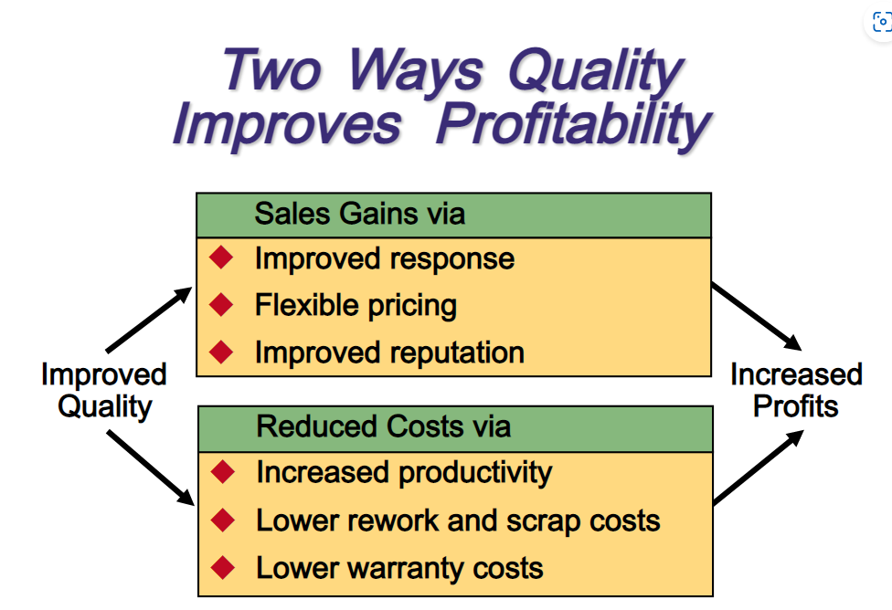

Slide 4
Dimensions of Quality
Performance - main characteristics of the product/service
Aesthetics - appearance, feel, smell, taste
Special Features - extra characteristics
Conformance - how well product/service conforms to customer’s expectations
Reliability - consistency of performance

Slide 5
Dimensions of Quality (Cont’d)
Durability - useful life of the product/service
Perceived Quality - indirect evaluation of quality (e.g. reputation)
Serviceability - service after sale

Slide 6
Examples of Quality Dimensions

Slide 7
Examples of Quality Dimensions (Cont’d)

Slide 8
Determinants of Quality
Ease of
use
Design
Conforms to design
Service

Slide 9
Determinants of Quality (cont’d)
Quality of design
Intension of designers to include or exclude features in a product or service
Quality of conformance
The degree to which goods or services conform to the intent of the designers

Slide 10

The Consequences of Poor Quality
Loss of business
Liability
Productivity
Costs

Slide 11
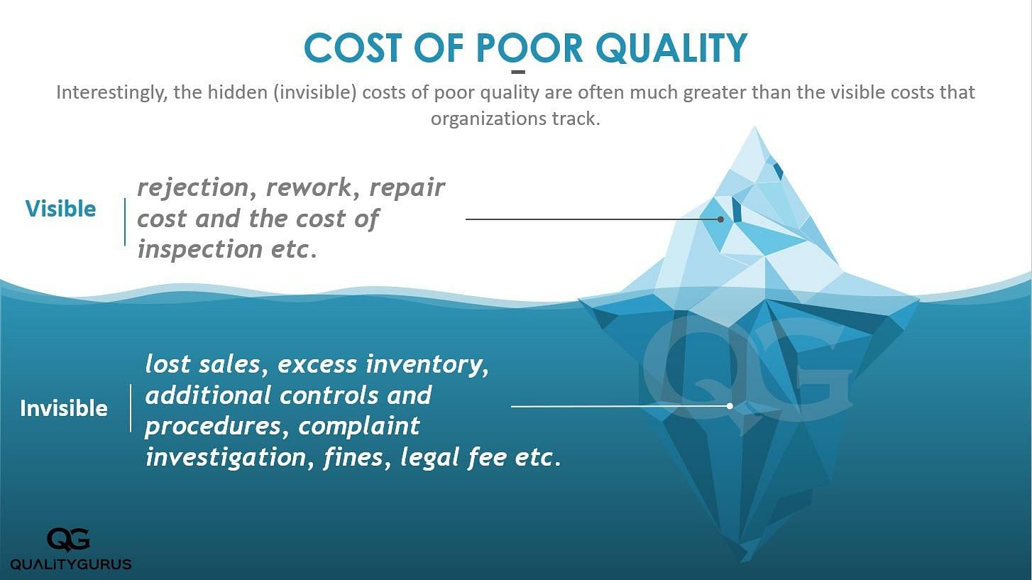

Slide 12
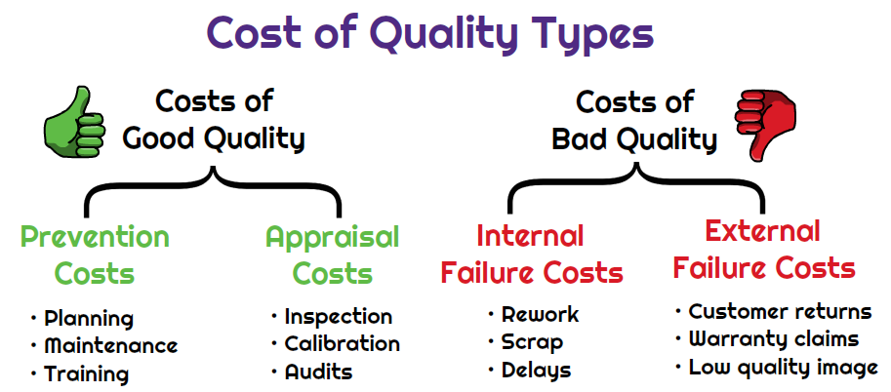

Slide 13
Costs of Quality
Failure Costs - costs incurred by defective parts/products or faulty services.
Internal Failure Costs
Costs incurred to fix problems that are detected before the product/service is delivered to the customer.
External Failure Costs
All costs incurred to fix problems that are detected after the product/service is delivered to the customer.

Slide 14
Reasons
Internal failures occur for a variety of reasons:
Defective materials from vendors
Incorrect machine settings
Faulty equipment
Incorrect processing
Carelessness
Improper material handling procedures

Slide 15
Cost
Costs of internal failures include
Lost production time
Scrap and rework
Investigation costs
Possible equipment damage
Possible employee injury
Additional resources needed to perform the rework

Slide 16
Cost
The costs of external failures include:
Warranty work
Handling of complaints
Replacements
Liability
Payments to customers
Discount used to offset the inferior quality
Loss of customer goodwill
Opportunity costs related to lost sales

Slide 17
Contd..
Internal and external failure costs represents costs related to poor quality whereas appraisal and preventions costs represents investments for achieving good quality.

Slide 18
Costs of Quality (continued)
Appraisal Costs
Costs of activities designed to ensure quality or uncover defects
Cost of inspectors, testing, test equipment, labs etc..
Prevention Costs-relates to attempts to prevent defects from occurring.
All TQ training, TQ planning, customer assessment, process control, and quality improvement costs to prevent defects from occurring

Slide 19




Total Quality Management
A philosophy that involves everyone in an organization in a continual effort to improve quality and achieve customer satisfaction.
T
Q
M

Slide 20
The TQM Approach
Find out what the customer wants
Design a product or service that meets or exceeds customer wants
Design processes that facilitates doing the job right the first time
Keep track of results and use them to guide improvements in the system.
Extend these concepts to suppliers

Slide 21
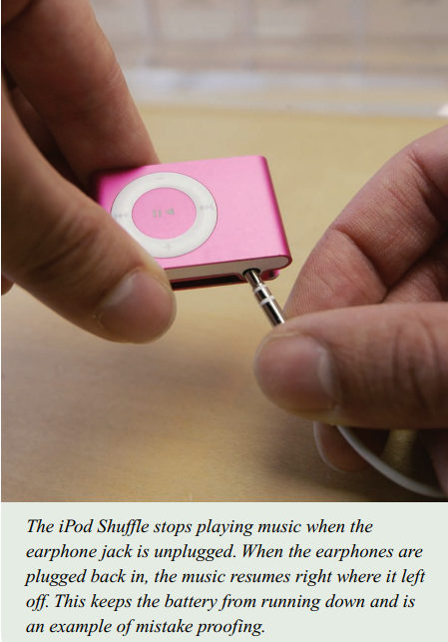
Fail Safing
Incorporating design elements that prevent incorrect procedures.
Eg- parts that fit together one way only
Appliance plugs that can be inserted into a wall outlet the correct way only.

Slide 22
Elements of TQM
Continual improvement
Competitive benchmarking
Employee empowerment
Team approach
Decisions based on facts
Knowledge of tools
Supplier quality
Champion
Quality at the source
Suppliers

Slide 23
Continuous Improvement
Philosophy that seeks to make never-ending improvements to the process of converting inputs into outputs.
Kaizen: Japanese word for continuous improvement.

Slide 24
Quality at the Source
The philosophy of making each worker responsible for the quality of his or her work.

Slide 25
It places direct responsibility for quality on the persons who directly affects it
Removes the adversarial relationship between quality control inspectors and production workers
Motivates workers by giving them control over their work as well as pride in it.

Slide 26
Basic Quality Tools
Flowcharts
Check sheets
Histograms
Pareto Charts
Scatter diagrams
Control charts
Cause-and-effect diagrams
Run charts

Slide 27
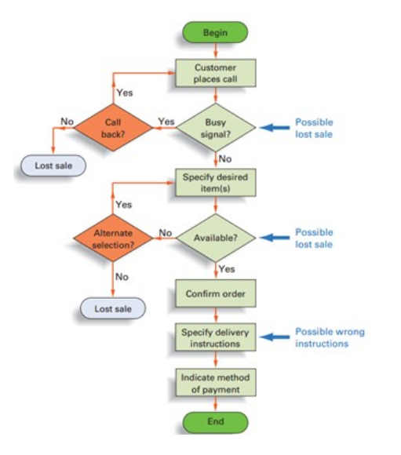
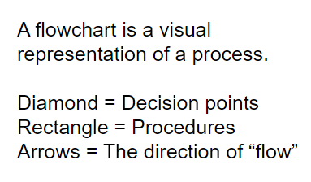
FLOWCHARTS

Slide 28
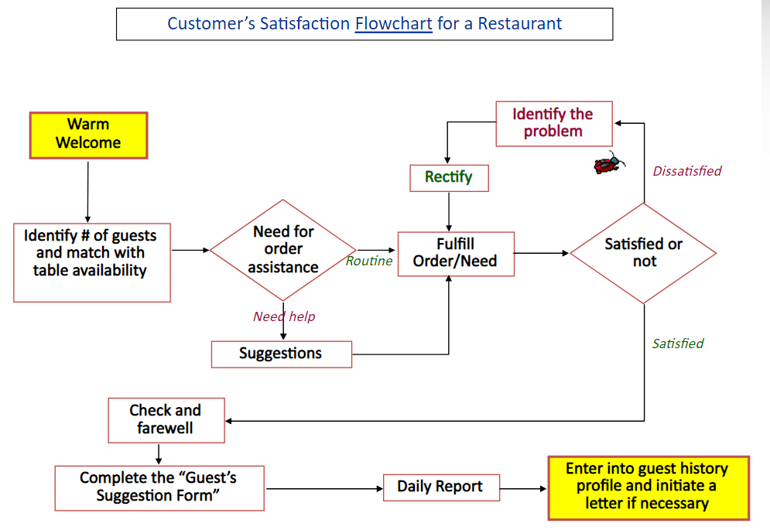

Slide 29
Check Sheet
Monday
Billing Errors
Wrong Account
Wrong Amount
A/R Errors
Wrong Account
Wrong Amount

Slide 30
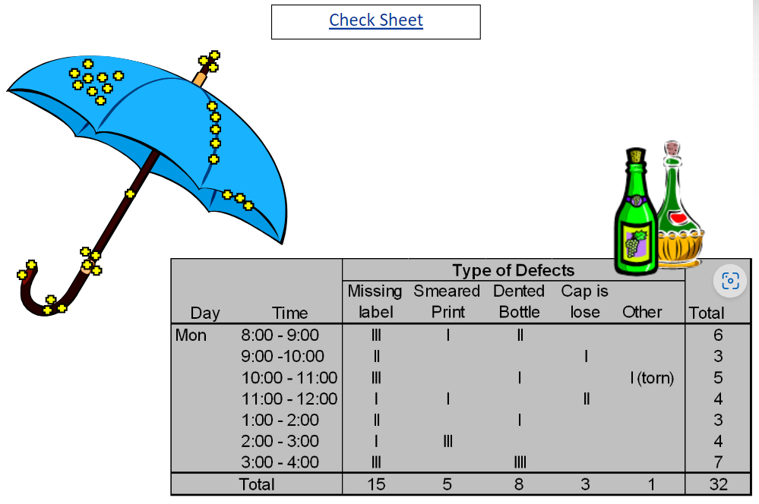

Slide 31
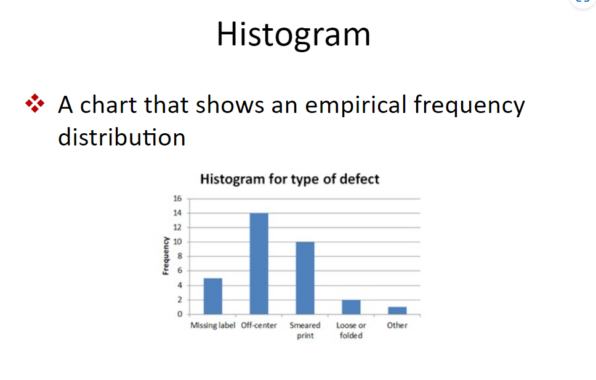

Slide 32
Pareto Analysis
80% of the problems may be attributed to 20% of the
causes.
Number of defects
Off center
Smeared
print
Missing
label
Loose
Other

Slide 33
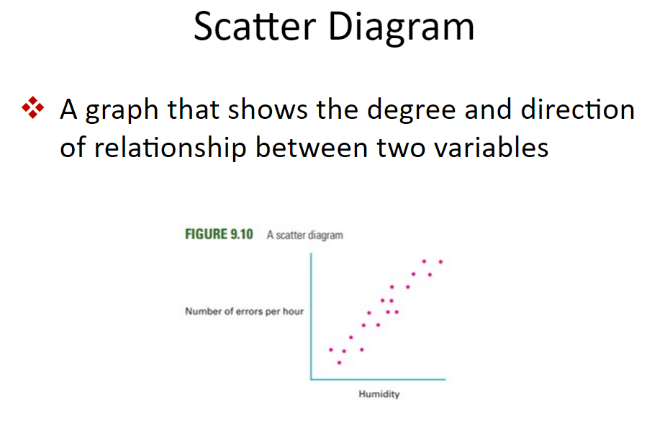

Slide 34
Control Chart
Figure 9.11
1020
UCL
1010
1000
990
LCL
980
970
0
1
2
3
4
5
6
7
8
9
10
11
12
13
14
15

Slide 35
Cause-and-Effect Diagram
Figure 9.12
Methods
Materials
Cause
Cause
Cause
Cause
Effect
Cause
Cause
Environment
Cause
Cause
Cause
Cause
Cause
Cause
People
Equipment

Slide 36
